Slide 1
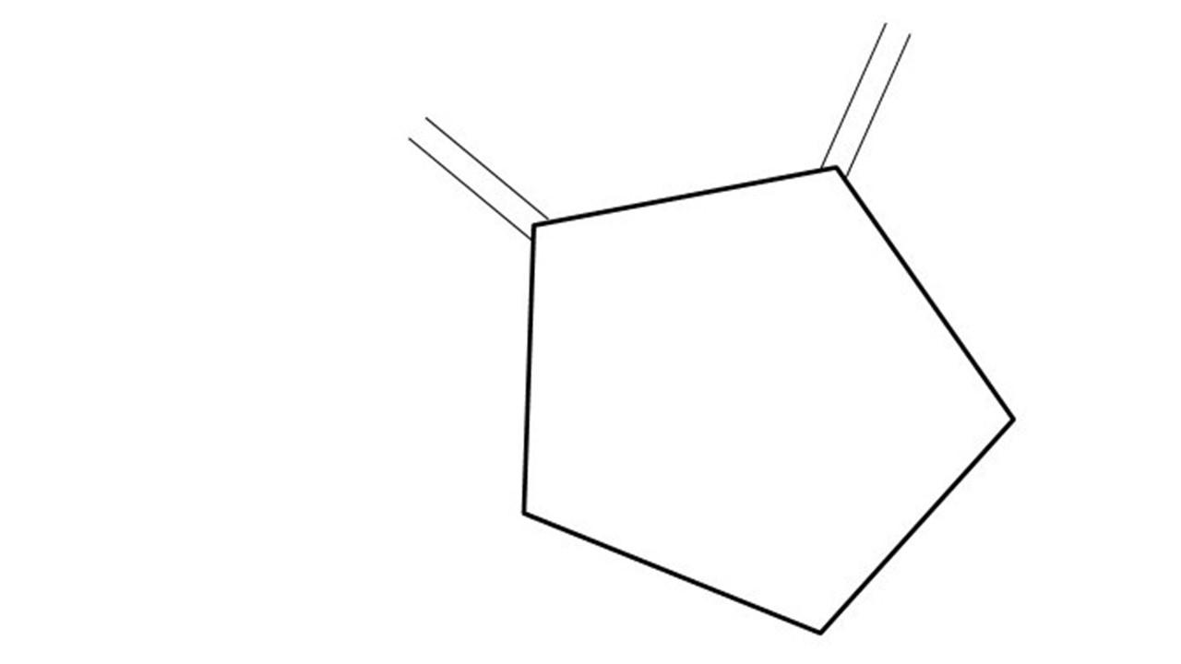
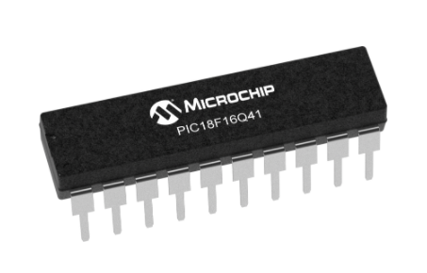
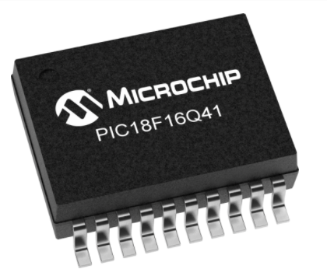
Great Cow BASIC Part 17
Great Cow BASIC for the PIC18FxxQ41 chip Family
January 2021

Slide 2
PIC18FxxQ41
PIC18-Q41 is a high performance PIC18
Digital and Analog peripherals
12-bit ADC
Multiple communication interfaces
Serial, I2C, SPI
PWM – CCP/PWM and 16Bit
Configurable Logic Cells
The PIC18xxQ41 offers 14- and 20-pin products in small footprint packages to support customers in a variety of space constrained and sensor node applications.

Slide 3
Videos...
Install the hardware and make the board work – three LED programs
Make four LEDs flash in a sequence
Set the LEDs to represent the value of ADC
Sequence the LEDs with a delay using the value of ADC
Using an input to set the state of the LED
Using the reset switch
Using the switch, ADC – the LEDs flash in a sequence with reverse
Using the serial to display values
Using the timer0 overflow, 8bit timer, 16bit timer to flash the LEDs
Using CCP/PWM to dim the LEDS
Using I²C with serial to discover I2C devices
Using EEProm – showing values on the serial terminal
Using an I²C GCLD display
Using an SPI GCLD display
Using PWM to dim the LEDS
Using memory within the PIC – Progmem and SAF memory
The Great Cow BASIC tool chain
Assembly and alternatives assemblers
Summary

Slide 4
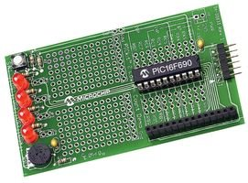
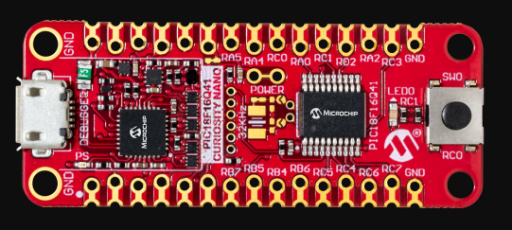

Hardware
Microchip Low Pin Count Demo Board
PICKit_2_Low_Pin_Count_User_Guide_51556a.pdf

Slide 5
Great Cow BASIC Compiler
Great Cow BASIC is an Open Source compiler for PIC, AVR and LGT microcontrollers
Great Cow BASIC now supports the 18FxxQ41 chip family
Great Cow BASIC is a cross platform with common code translation
Great Cow BASIC Compiler

Slide 6
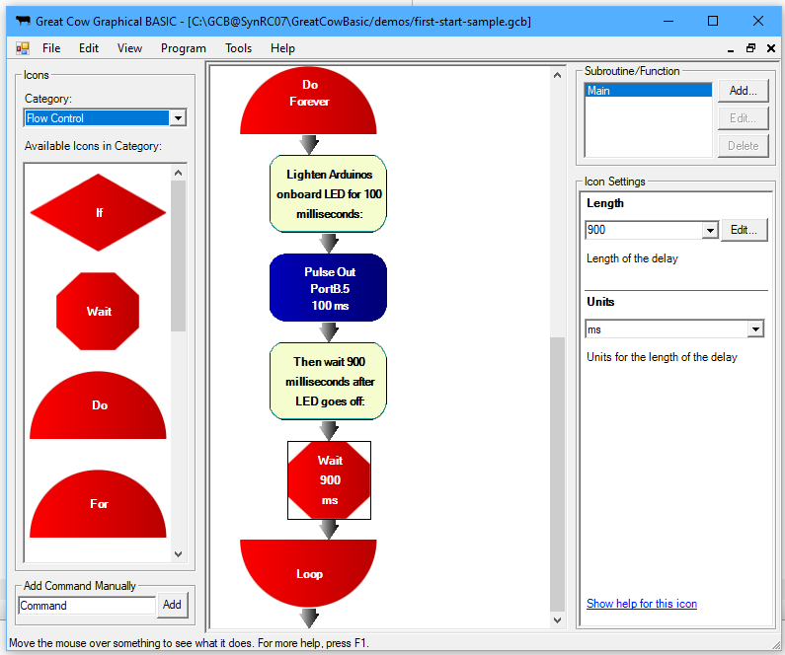
Great Cow Graphical BASIC
PPSTool
CLC
Great Cow Graphical BASIC
Great Cow BASIC Compiler
Programmers
PSMC

Slide 7
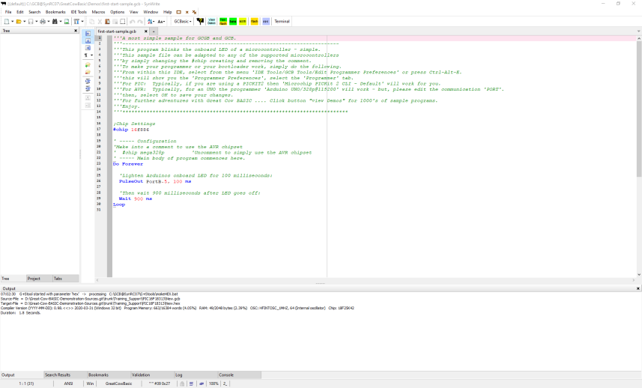
The Windows IDE
PPSTool
CLC
PicInfo
PSMC
SynWrite IDE
Great Cow BASIC Compiler
Programmers
G+Stool
Program Editor
Terminal

Slide 8
Tool chain

Slide 9
The core compiler
High Level Language
Reports:
TXT and HTML
Source Code
Great Cow BASIC Compiler
Great Cow BASIC Compiler
Preprocessor
Code Translator
Assembler
Linker
Assembly Language
ASM file
Absolute Machine Code
HEX file
Libraries
8 bit PIC and AVR

Slide 10
Compiler options
High Level Language
Reports:
TXT and HTML
Source Code
PIC-AS, MPASM,
MPLAB-IDE,
GPASM, etc
Great Cow BASIC Compiler
Great Cow BASIC Compiler
Preprocessor
Code Translator
Assembler
Linker
Assembly Language
file
Absolute Machine Code
HEX file
Libraries
8 bit PIC and AVR

Slide 11
The Variants for Linux, BSD & Mac
$ time LC_ALL=C /opt/GCBASIC/makehex.sh code9.gcb Great Cow BASIC (0.98.07 RC07 2020-04-01 (Linux 64 bit)) Compiling code9.gcb ... Done Assembling program ... Program assembled successfully! real 0m2,947s user 0m2,886s sys 0m0,045s
An Editor
Great Cow BASIC Compiler
Programmers
Scripts

Slide 12
Lab
We will
Review PICINFO
Review PPSTool
Edit Preferences and code portability
Review CLCTool and usage

Slide 13
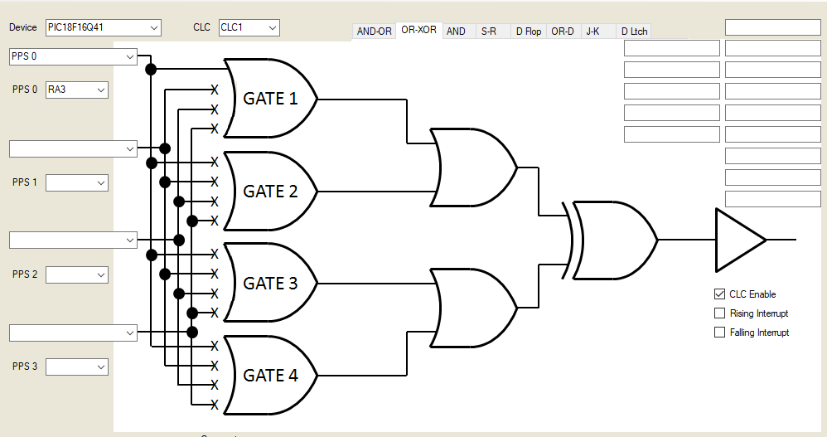
Lab
Configurable Logic Cell on PIC MCUs
The CLC has a variety of basic gates as well as sequential logic options that can be customised to create the logic specific to your application.
Through these logic gates, the CLC gives you the ability to combine signals to make a new custom signal without running code to execute it.
Example – switch to LEDs with no cpu code
We will
Review PICINFO
Review PPSTool
Edit Preferences and code portability
Review CLCTool and usage

Slide 14
Tool chain

Slide 15
Videos...
Install the hardware and make the board work – three LED programs
Make four LEDs flash in a sequence
Set the LEDs to represent the value of ADC
Sequence the LEDs with a delay using the value of ADC
Using an input to set the state of the LEDs
Using the reset switch
Using the switch, ADC – the LEDs flash in a sequence with reverse
Using the serial to display values
Using the timer0 overflow, 8bit timer, 16bit timer to flash the LEDs
Using CCP/PWM to dim the LEDS
Using I2C with serial to discover I2C devices
Using EEProm – showing values on the serial terminal
Using an I2C GCLD display
Using an SPI GCLD display
Using PWM to dim the LEDS
Using memory within the PIC – Progmem and SAF memory
The Great Cow BASIC tool chain
Assembly and alternatives assemblers
Summary

Slide 16
Great Cow BASIC
Great Cow BASIC for the PIC18FxxQ41 chip Family
January 2021

Slide 18
Backup Slides

Slide 19
Great Cow BASIC – PIC, AVR and LGT
High Level Language
Reports:
TXT and HTML
Source Code
Great Cow BASIC Compiler
Great Cow BASIC Compiler
Preprocessor
Code Translator
Assembler
Linker
Assembly Language
ASM file
Absolute Machine Code
HEX file
Libraries
8 bit PIC, AVR and LGT

